Slide 1
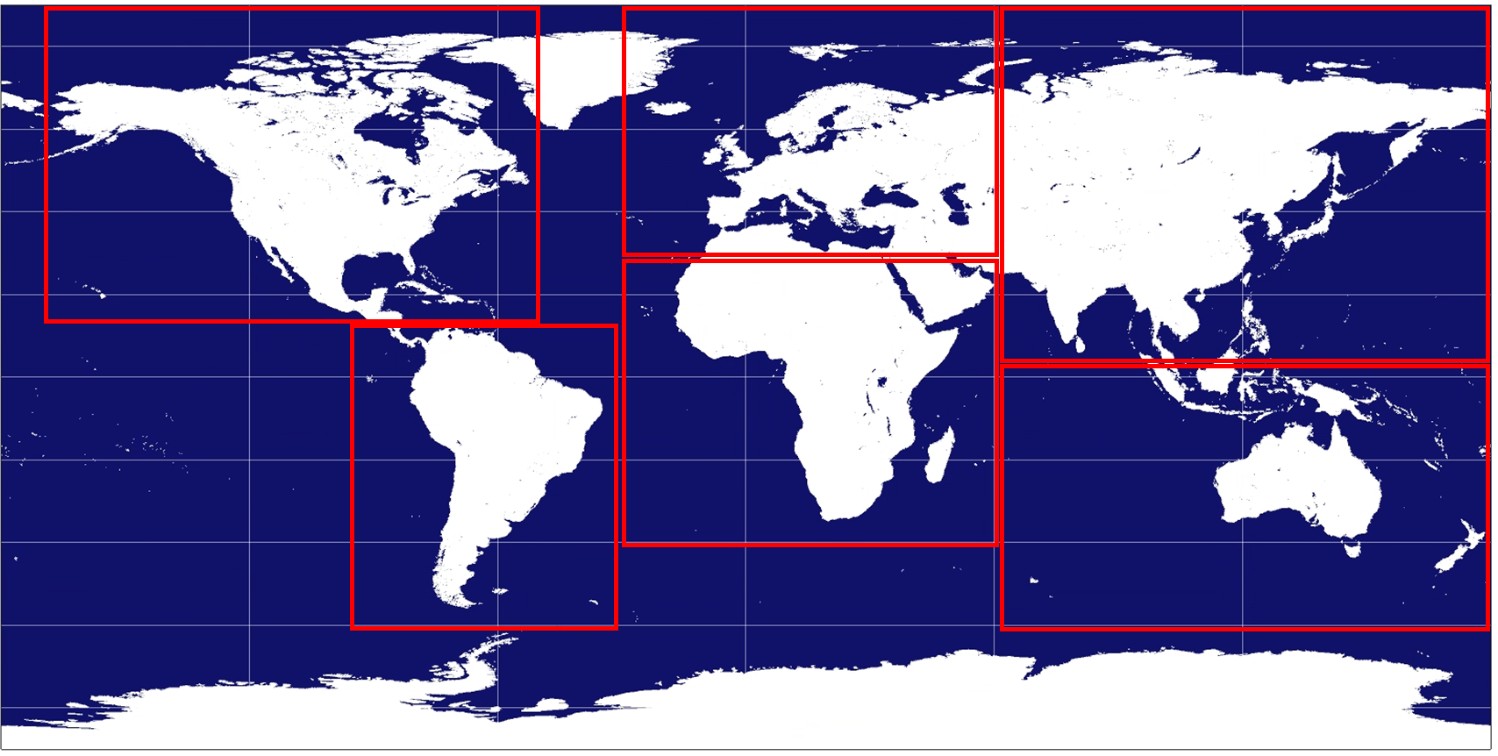
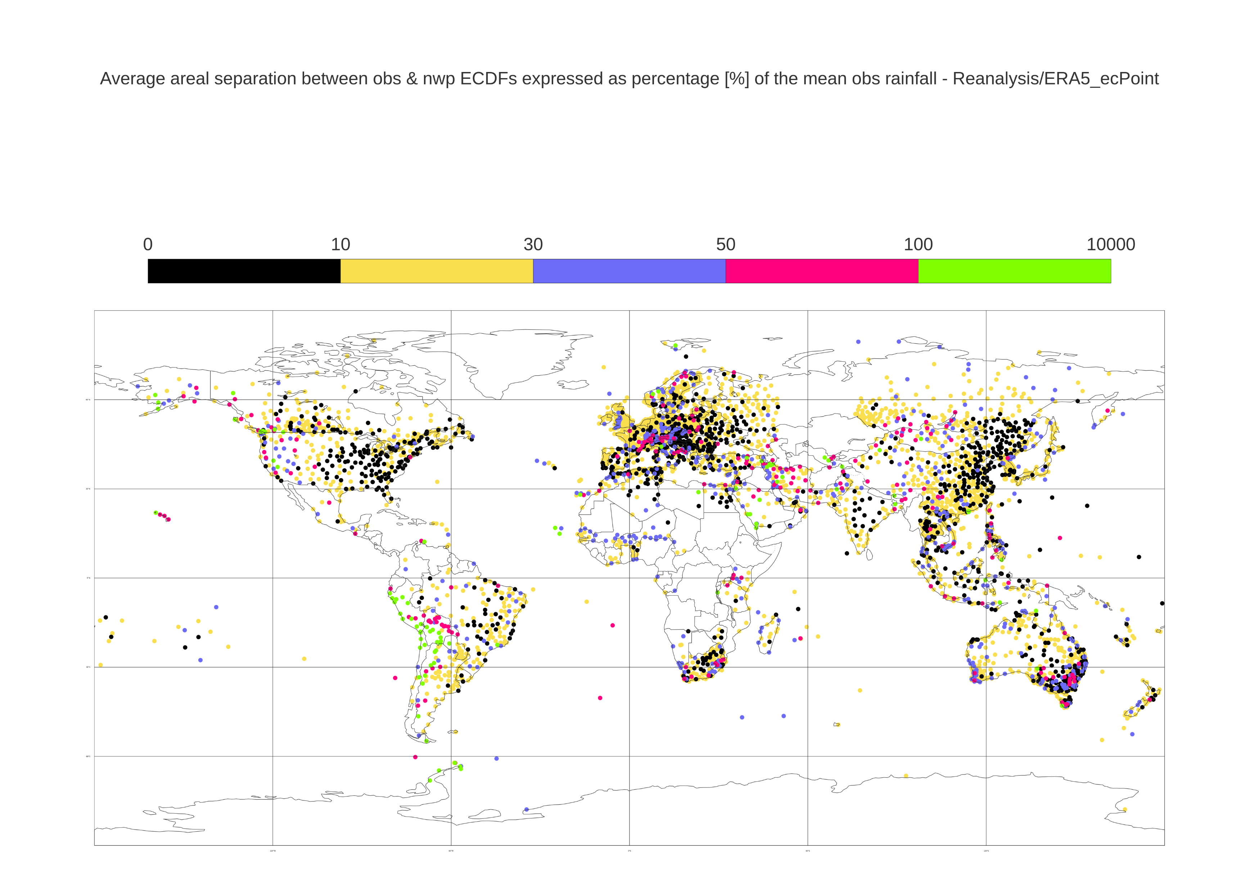
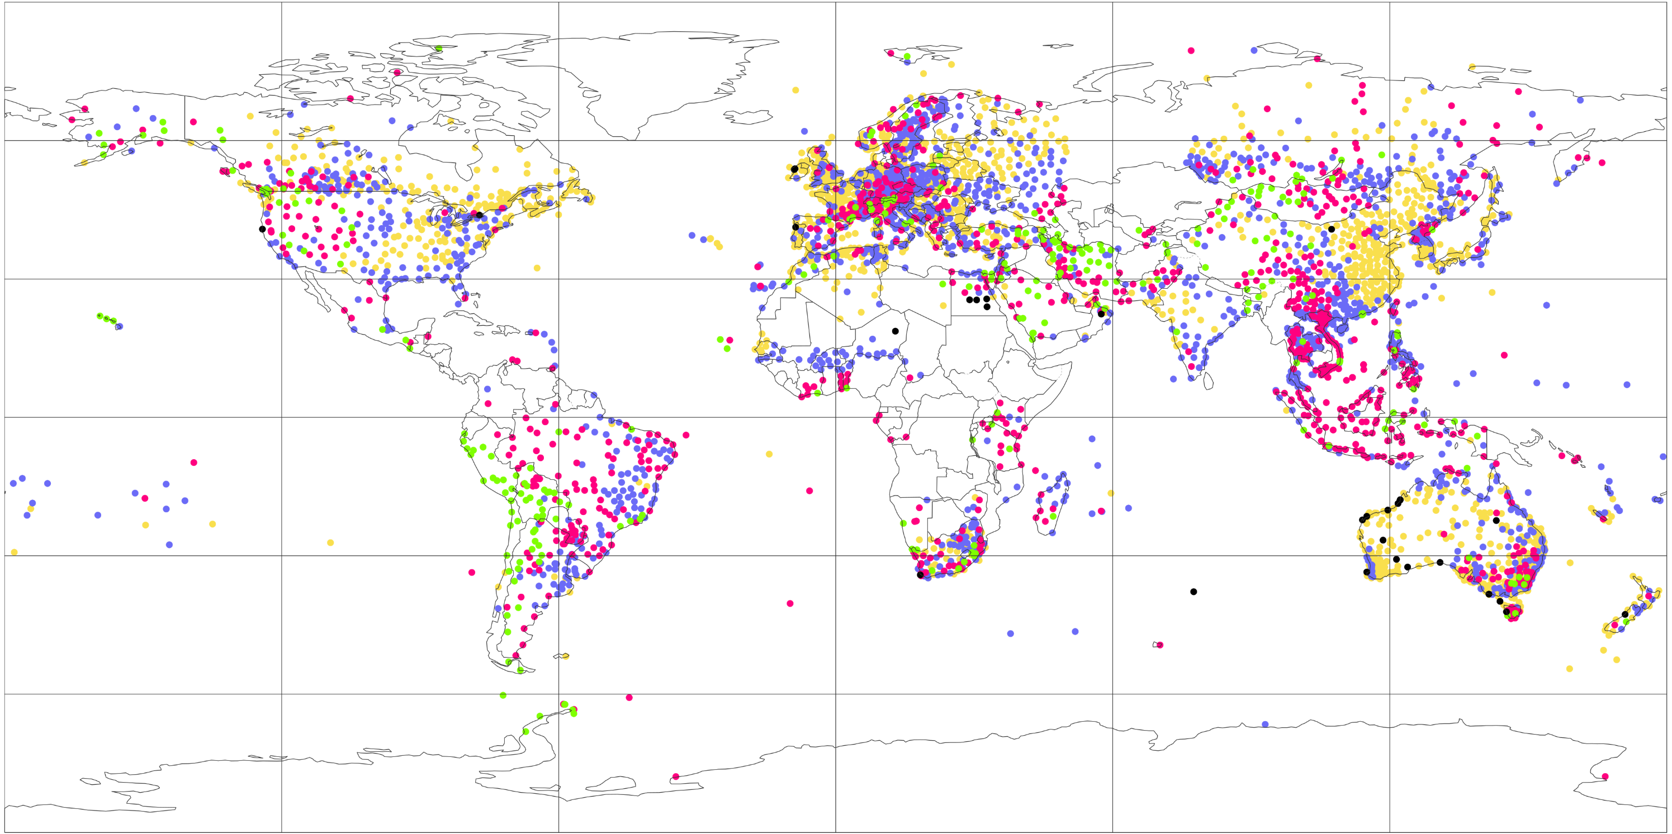
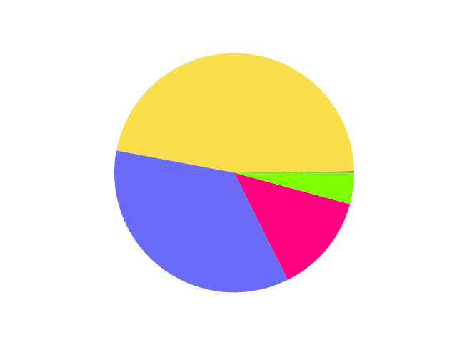
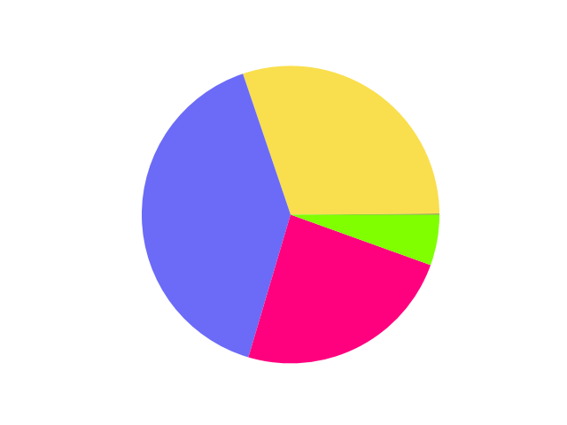
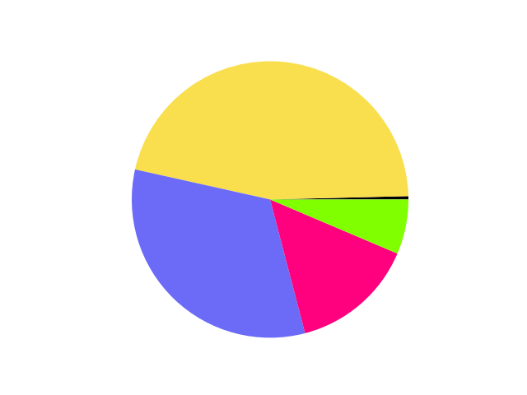
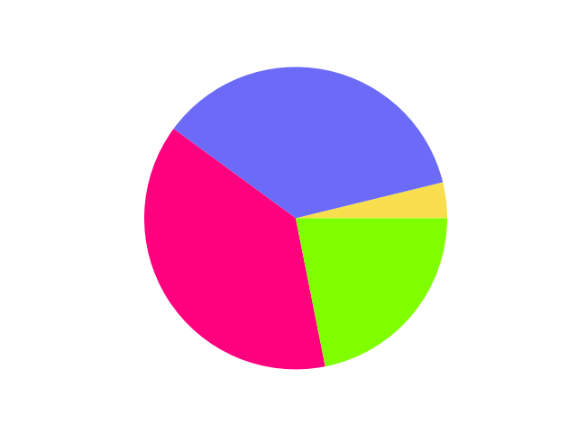
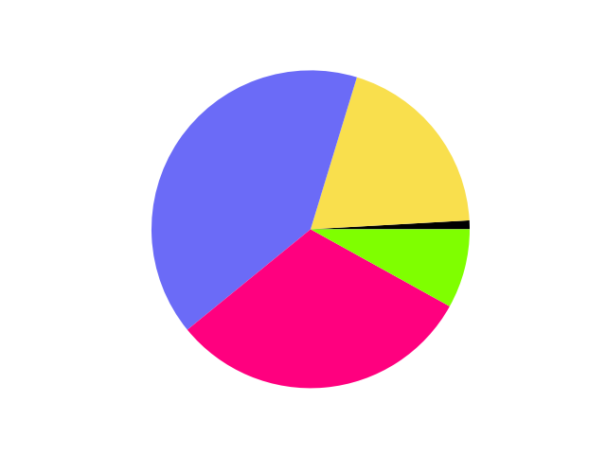
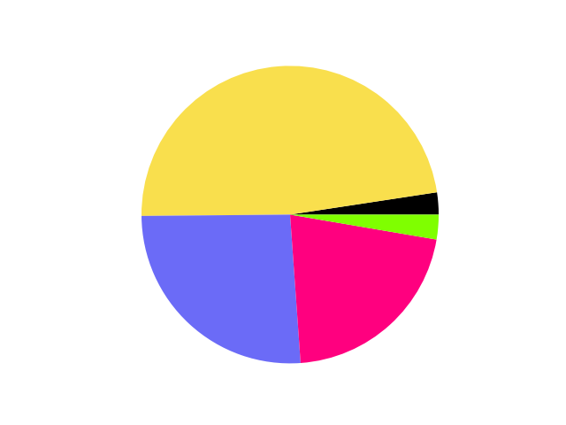
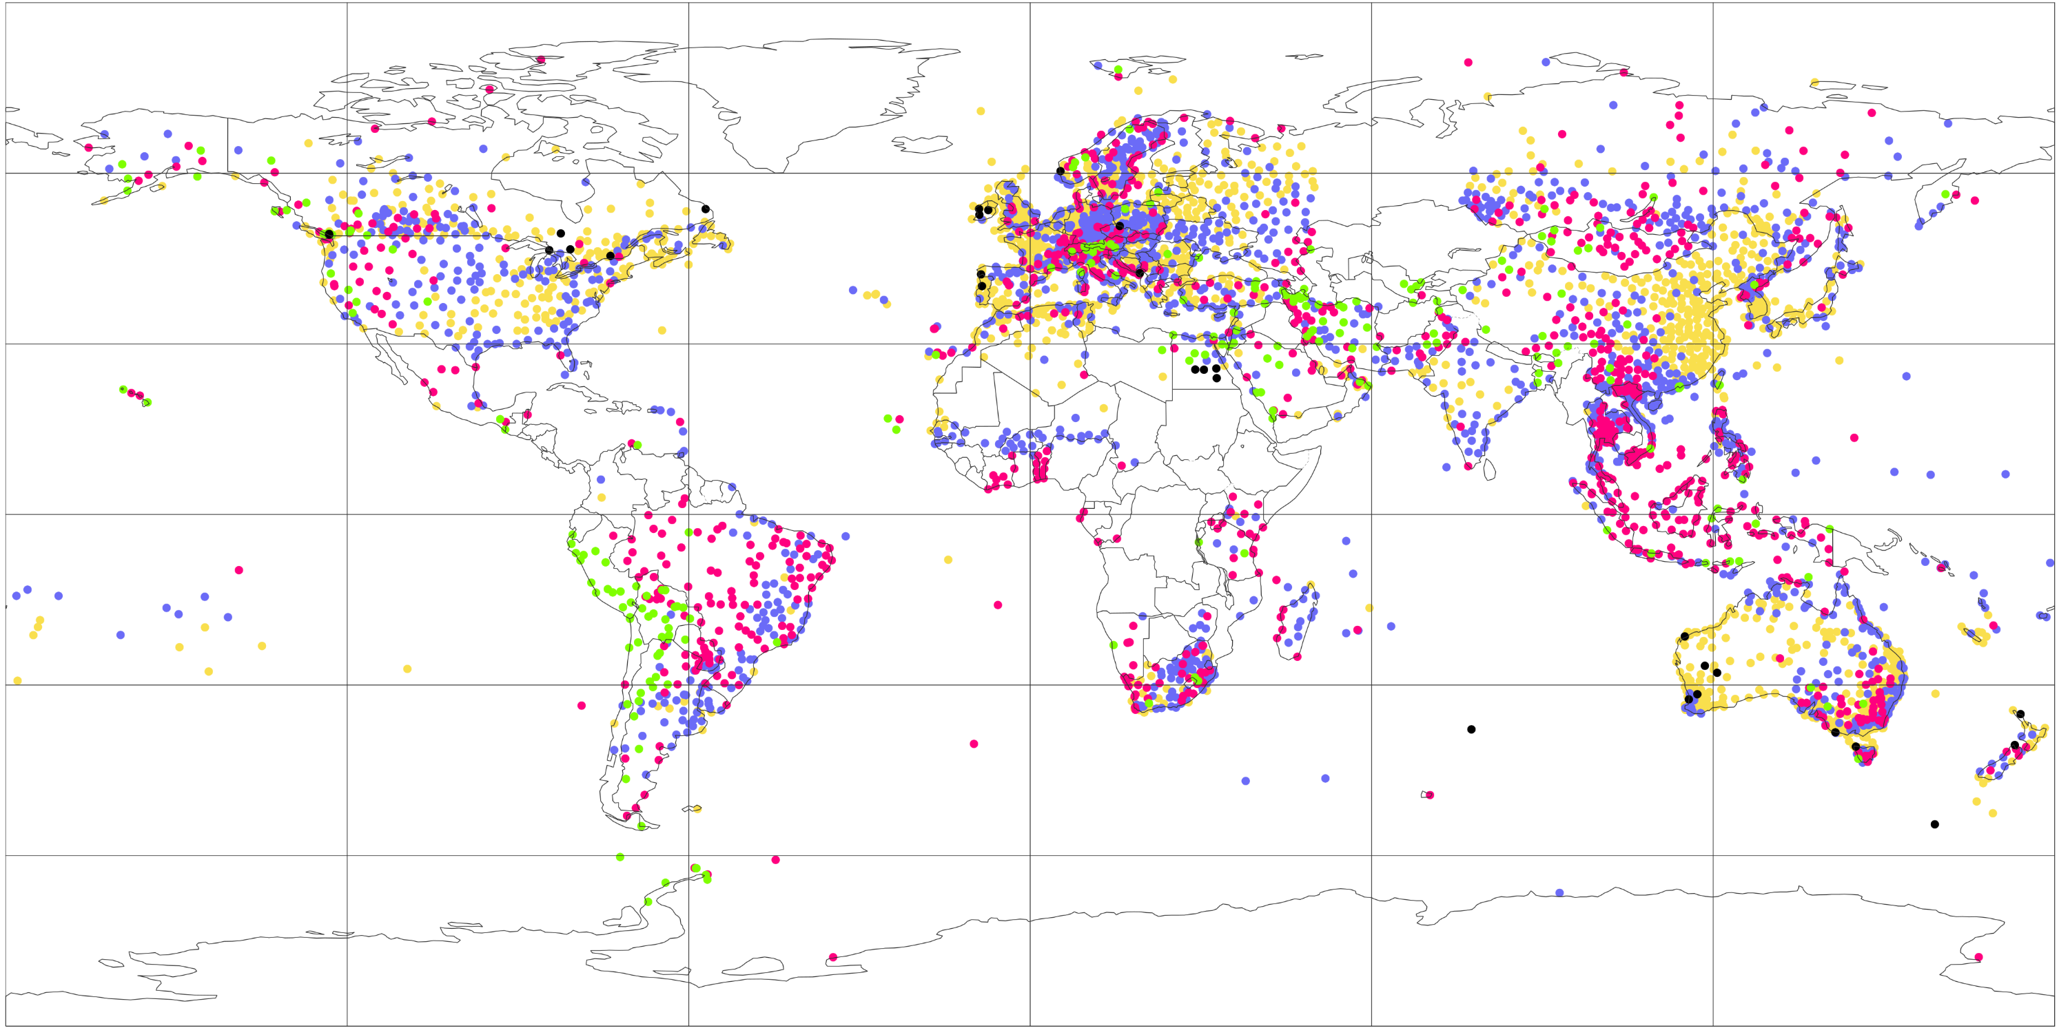
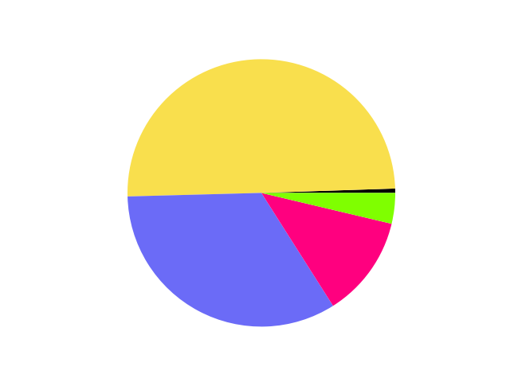
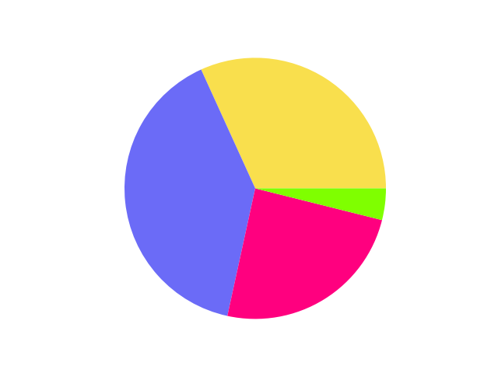
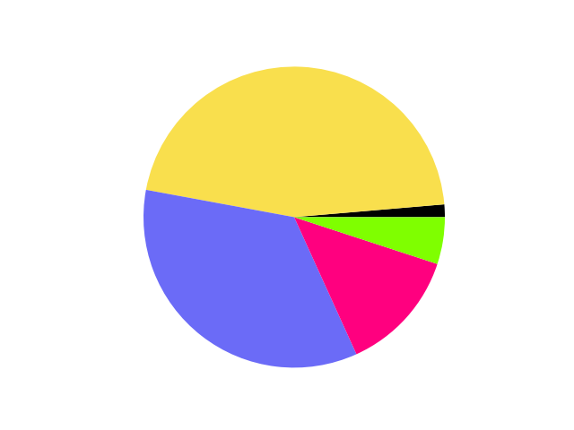
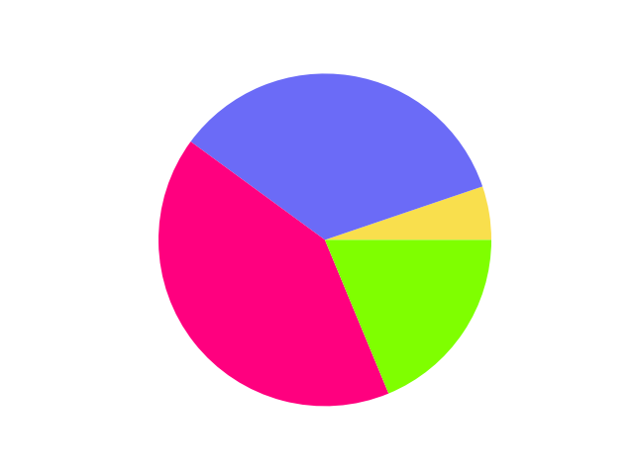
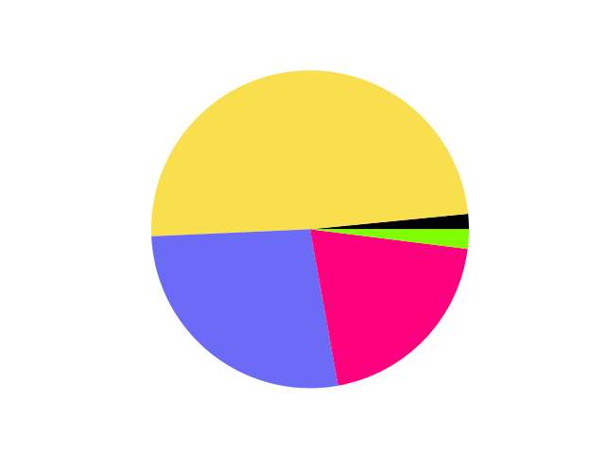

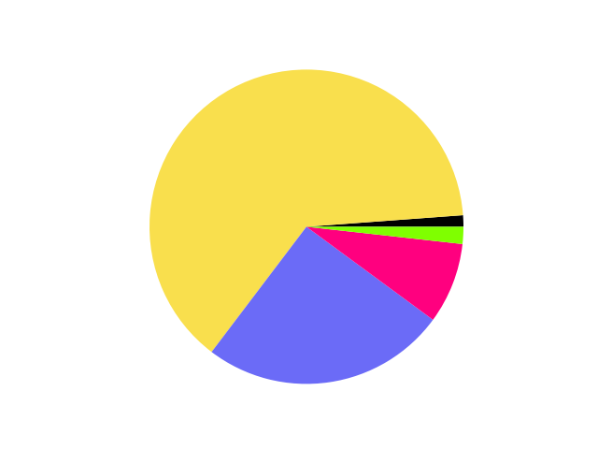
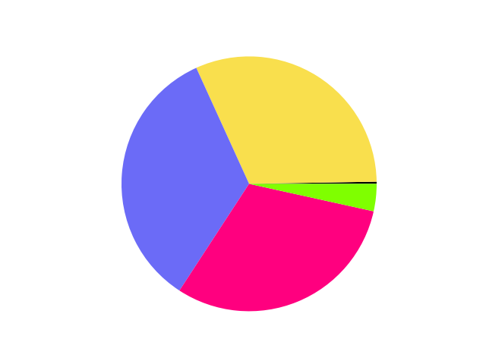
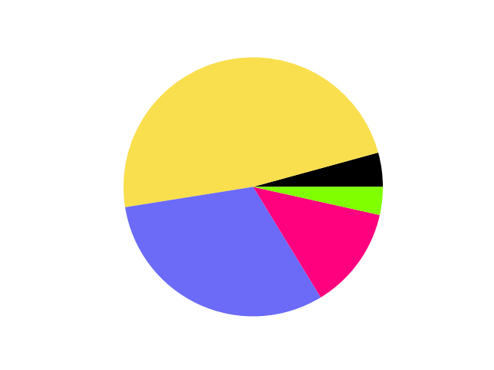
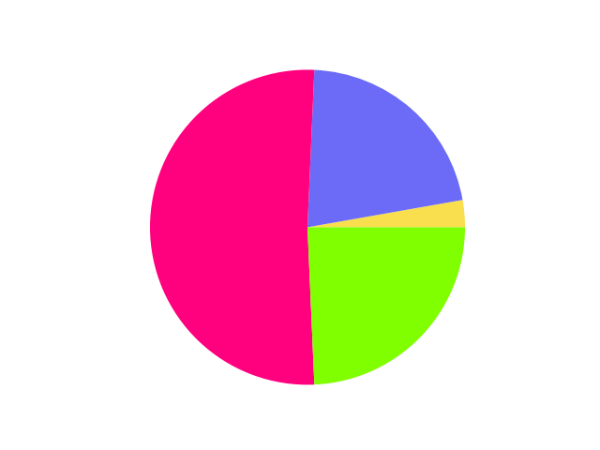
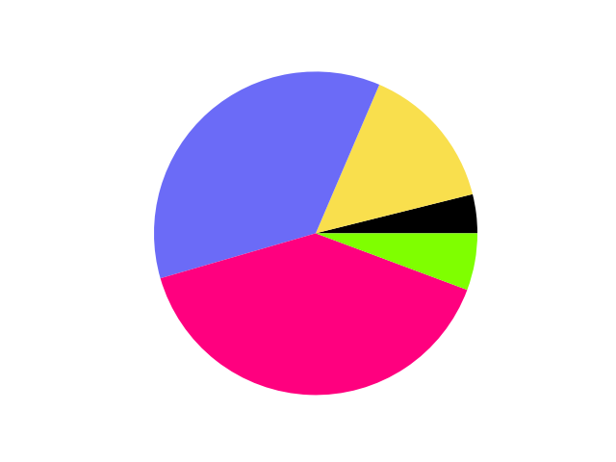
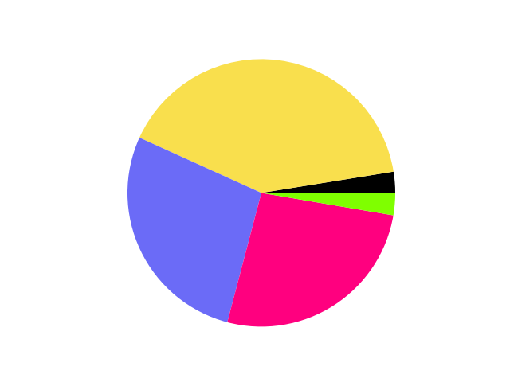
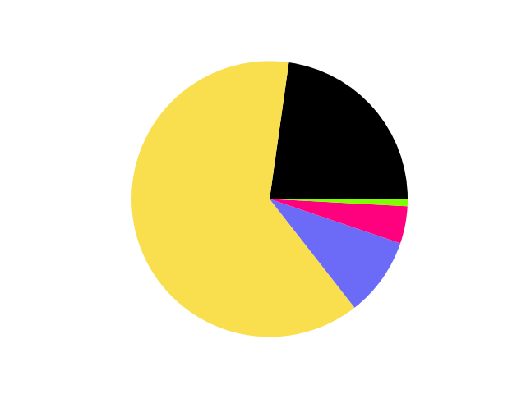
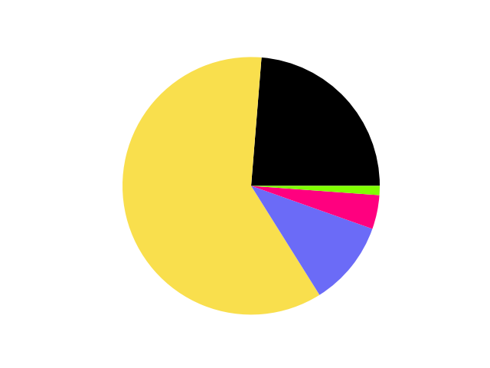
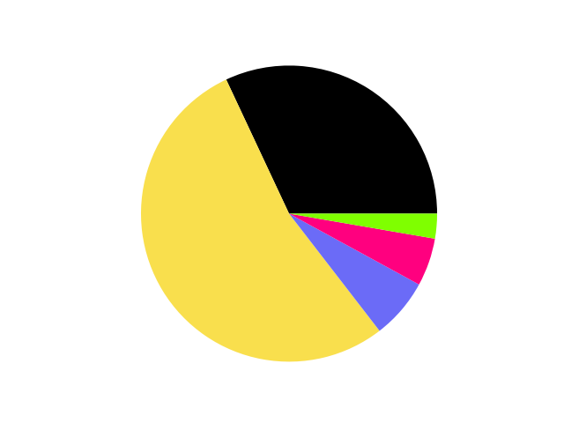
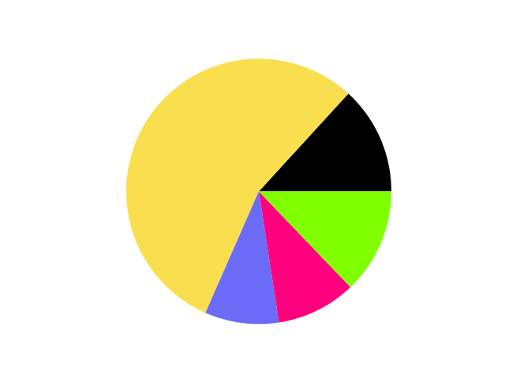
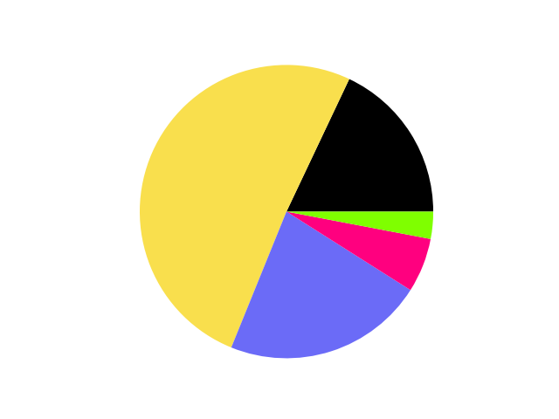
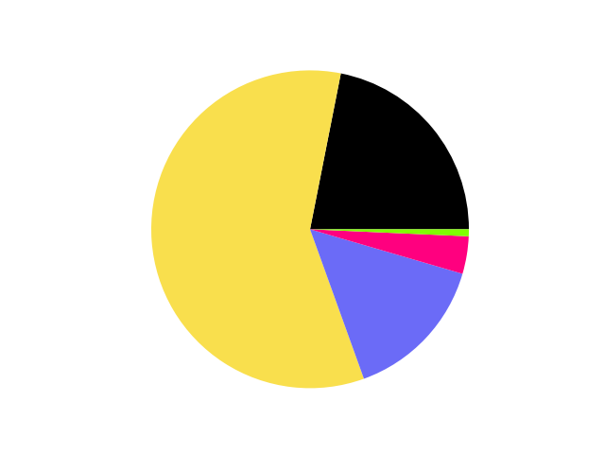
Empirical Quantile Analysis
Areal difference between observed and NWP rainfall realisations, expressed as % of the station’s mean observed rainfall
North America [90 °N, 170 °W, 15 °N, 50 °W]
(a) Domains to create the piecharts
South America [15 °N, 100 °W, 60 °S, 30 °W]
Europe & Mediterranean [90 °N, 30 °W, 30 °N, 60 °E]
Africa & Arabian Peninsula [30 °N, 30 °W, 40 °S, 60 °E]
Asia [90 °N, 60 °E, 5 °N, 180 °E]
Oceania [5 °N, 60 °E, 60 °S, 180 °W]
0
10
30
50
100
10000 %
(b) ERA5 – EDA (62 km)
60 °N
30 °N
70 °S
0 °N
30 °S
60 °S
(c) ERA5 (31 km)
60 °N
30 °N
0 °N
30 °S
60 °S
(d) ECMWF Reforecasts - 46r1 (18 km)
60 °N
30 °N
0 °N
30 °S
60 °S
(e) ERA5–ecPoint (point-scale in 31 km grid)
60 °N
30 °N
0 °N
30 °S
60 °S
120 °W
60 °W
0 °E
60 °E
120 °E

